Slide 1
8
Statistical Intervals for a Single Sample
CHAPTER OUTLINE
8-1 Introduction
8-2 Confidence Interval on the Mean of a Normal, σ² Known
8-2.1 Development of the Confidence Interval & Its Properties
8-2.2 Choice of Sample Size
8-2.3 1-Sided Confidence Bounds
8-2.4 General Method to Derive a Confidence Interval
8-2.5 Large-Sample Confidence Interval for μ
8-3 Confidence Interval on the Mean of a Normal, σ² Unknown
8-3.1 t Distribution
8-3.2 t Confidence Interval on μ
8-4 Confidence Interval on σ² & σ of a Normal Distribution
8-5 Large-Sample Confidence Interval for a Population Proportion
8-6 Guidelines for Constructing Confidence Intervals
8-7 Tolerance & Prediction Intervals
8-7.1 Prediction Interval for a Future Observation
8-7.2 Tolerance Interval for a Normal Distribution
Notes:
Dear Instructor: You may note a difference in style between the lecture slides for Chapters 8-15, as compared to Chapters 1-7. Two different instructors authored these lecture slides, so that they may be completed in time for their use in preparing lectures.

Slide 2
Learning Objectives for Chapter 8
After careful study of this chapter, you should be able to do the following:
Construct confidence intervals on the mean of a normal distribution, using either the normal distribution or the t distribution method.
Construct confidence intervals on the variance and standard deviation of a normal distribution.
Construct confidence intervals on a population proportion.
Use a general method for constructing an approximate confidence interval on a parameter.
Construct prediction intervals for a future observation.
Construct a tolerance interval for a normal population.
Explain the three types of interval estimates: Confidence intervals, prediction intervals, and tolerance intervals.

Slide 3
8-1 Introduction
In the previous chapter we illustrated how a parameter can be estimated from sample data. However, it is important to understand how good is the estimate obtained.
Bounds that represent an interval of plausible values for a parameter are an example of an interval estimate.
Three types of intervals will be presented:
Confidence intervals
Prediction intervals
Tolerance intervals

Slide 4
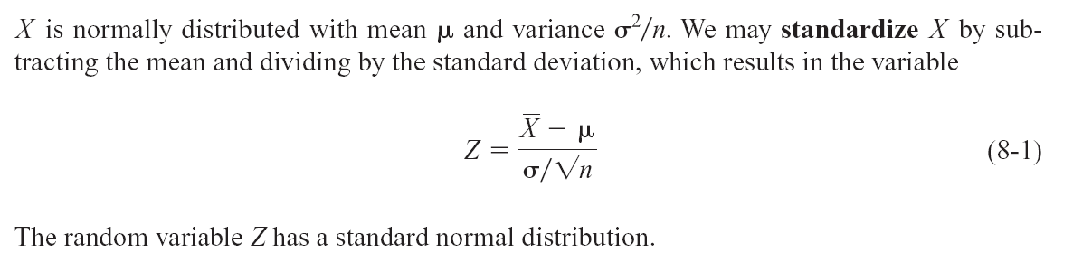
8-2 Confidence Interval on the Mean of a Normal Distribution, Variance Known
8-2.1 Development of the Confidence Interval and its Basic Properties (Eq. 8-1)

Slide 5
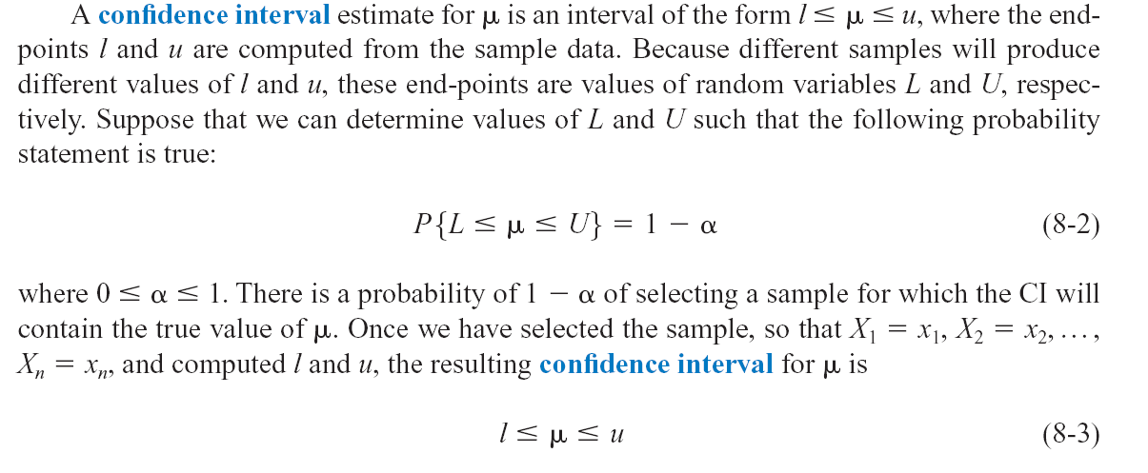
8-2 Confidence Interval on the Mean of a Normal Distribution, Variance Known
8-2.1 Development of the Confidence Interval and its Basic Properties (Eq. 8-2 & 3)

Slide 6
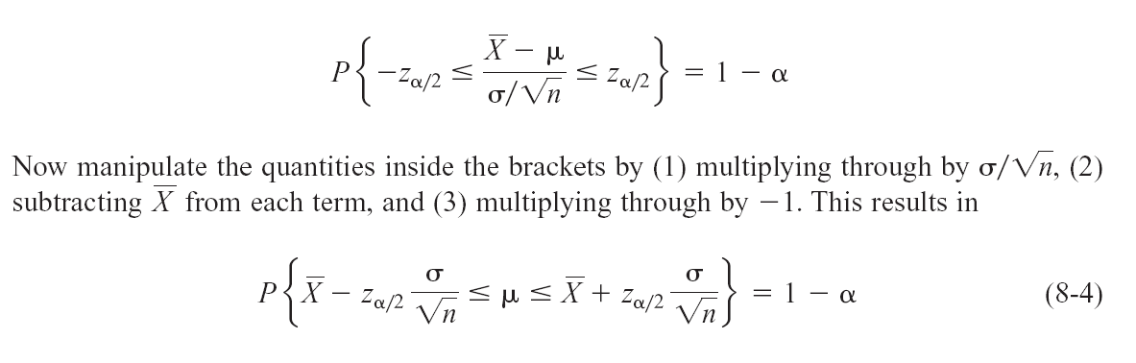
8-2 Confidence Interval on the Mean of a Normal Distribution, Variance Known
8-2.1 Development of the Confidence Interval and its Basic Properties (Eq. 8-4)
The endpoints or bounds l and u are called lower- and upper-confidence limits, respectively.
Since Z follows a standard normal distribution, we can write:

Slide 7
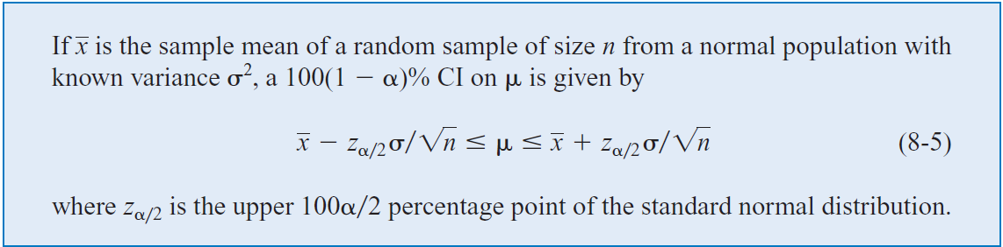
8-2 Confidence Interval on the Mean of a Normal Distribution, Variance Known
8-2.1 Development of the Confidence Interval and its Basic Properties (Eq. 8-5)
Definition

Slide 8
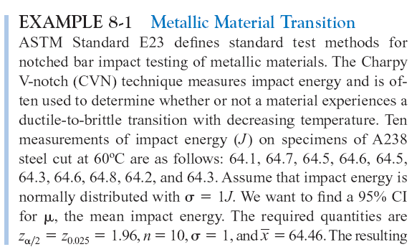
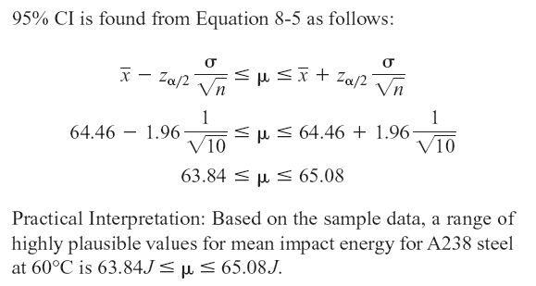
8-2 Confidence Interval on the Mean of a Normal Distribution, Variance Known
Example 8-1

Slide 9
8-2 Confidence Interval on the Mean of a Normal Distribution, Variance Known
Interpreting a Confidence Interval
The confidence interval is a random interval
The appropriate interpretation of a confidence interval (for example on μ) is: The observed interval [l, u] brackets the true value of μ, with confidence 100(1-α).
Examine Figure 8-1 on the next slide.

Slide 10
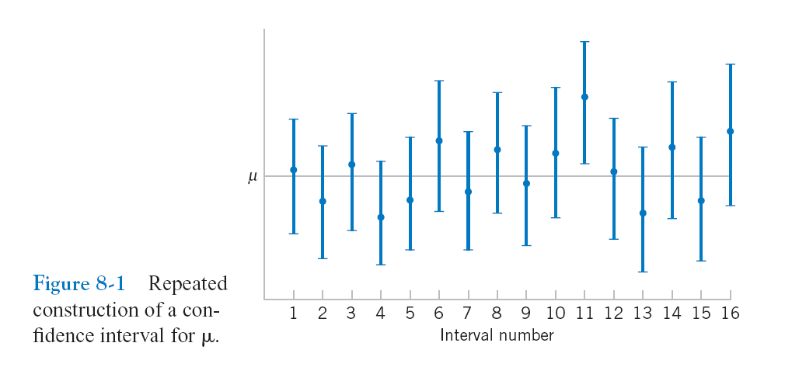
8-2 Confidence Interval on the Mean of a Normal Distribution, Variance Known
Figure 8-1 Repeated construction of a confidence interval for μ.

Slide 11
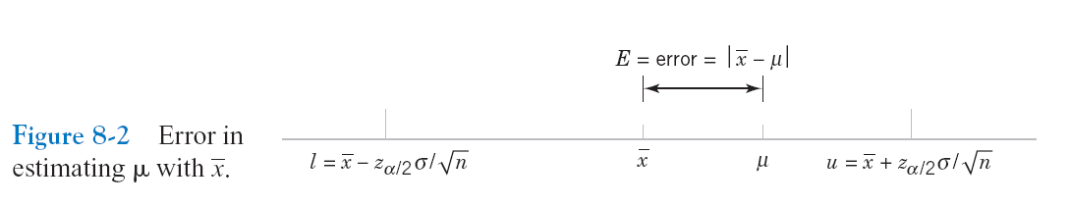
8-2 Confidence Interval on the Mean of a Normal Distribution, Variance Known
Confidence Level and Precision of Error
The length of a confidence interval is a measure of the precision of estimation.
Figure 8-2 Error in estimating μ with .

Slide 12
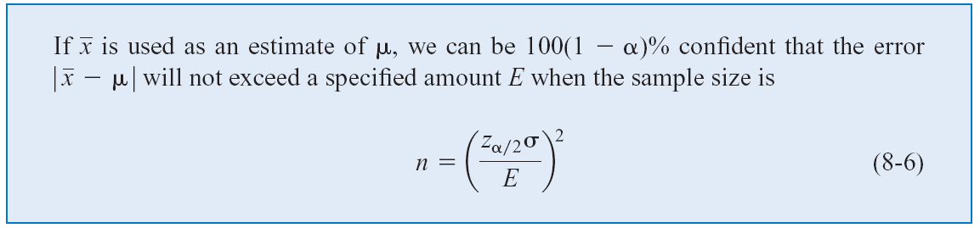
8-2 Confidence Interval on the Mean of a Normal Distribution, Variance Known
8-2.2 Choice of Sample Size (Eq. 8-6)
Definition

Slide 13
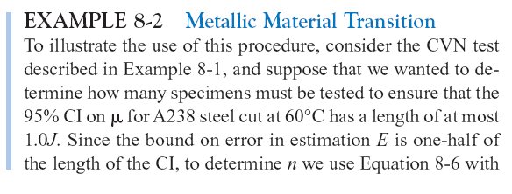
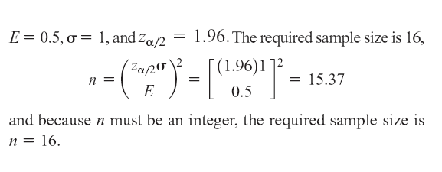
8-2 Confidence Interval on the Mean of a Normal Distribution, Variance Known
Example 8-2

Slide 14
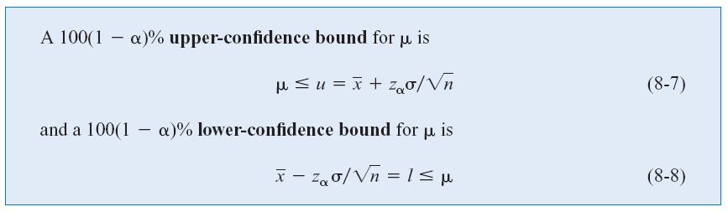
8-2 Confidence Interval on the Mean of a Normal Distribution, Variance Known
8-2.3 One-Sided Confidence Bounds (Eq. 8-7 & 8)
Definition

Slide 15
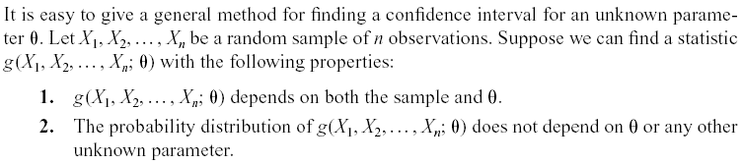
8-2 Confidence Interval on the Mean of a Normal Distribution, Variance Known
8-2.4 General Method to Derive a Confidence Interval

Slide 16
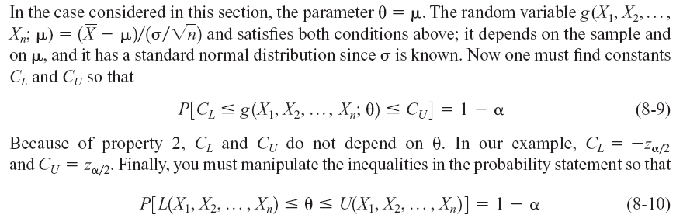
8-2 Confidence Interval on the Mean of a Normal Distribution, Variance Known
8-2.4 General Method to Derive a Confidence Interval (Eq. 8-9 & 10)

Slide 17
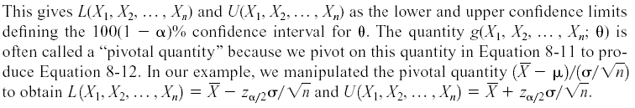
8-2 Confidence Interval on the Mean of a Normal Distribution, Variance Known
8-2.4 General Method to Derive a Confidence Interval

Slide 18
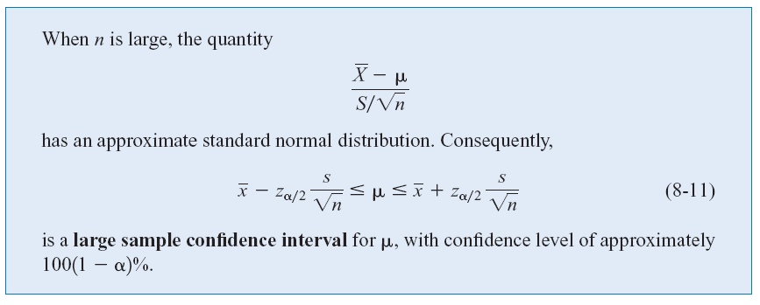
8-2 Confidence Interval on the Mean of a Normal Distribution, Variance Known
8-2.5 A Large-Sample Confidence Interval for μ (Eq. 8-11)
Definition

Slide 19
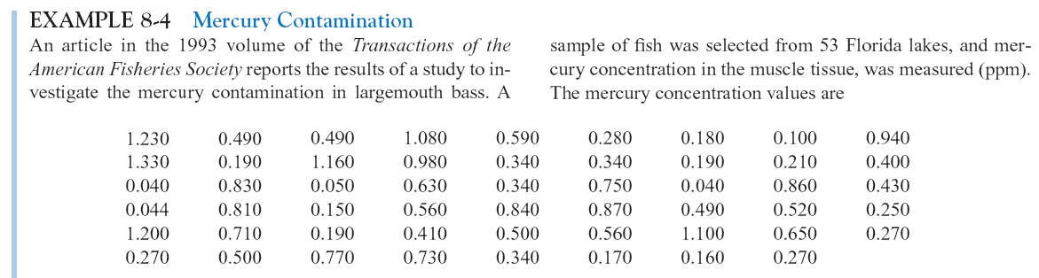
8-2 Confidence Interval on the Mean of a Normal Distribution, Variance Known
Example 8-4

Slide 20
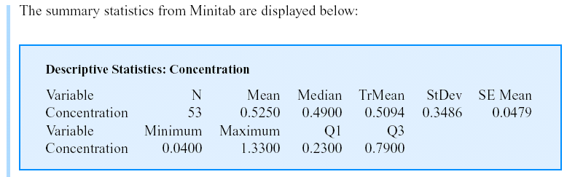
8-2 Confidence Interval on the Mean of a Normal Distribution, Variance Known
Example 8-4 (continued)

Slide 21
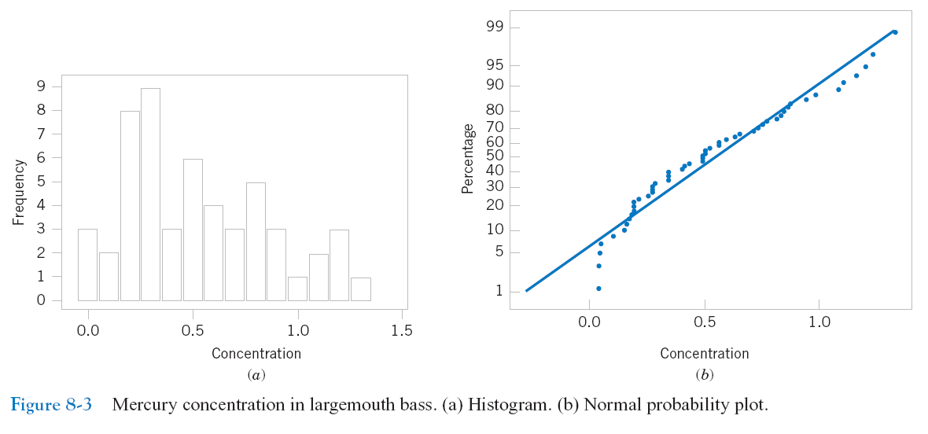
8-2 Confidence Interval on the Mean of a Normal Distribution, Variance Known
Example 8-4 (continued)
Figure 8-3 Mercury concentration in largemouth bass (a) Histogram. (b) Normal probability plot

Slide 22
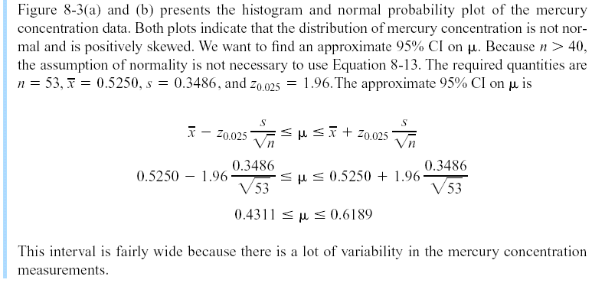
8-2 Confidence Interval on the Mean of a Normal Distribution, Variance Known
Example 8-4 (continued)

Slide 23
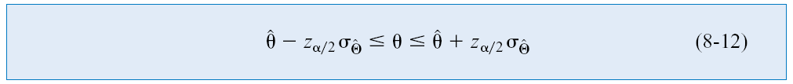
8-2 Confidence Interval on the Mean of a Normal Distribution, Variance Known
A General Large Sample Confidence Interval (Eq. 8-12)

Slide 24
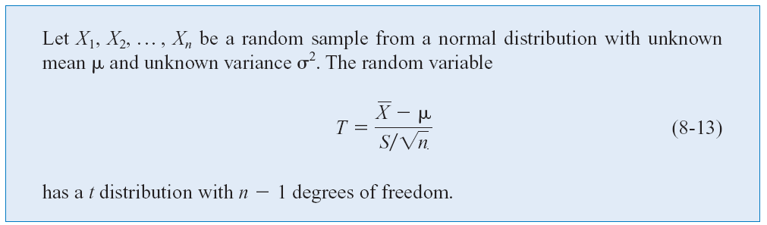
8-3 Confidence Interval on the Mean of a Normal Distribution, Variance Unknown
8-3.1 The t distribution (Eq. 8-13)

Slide 25
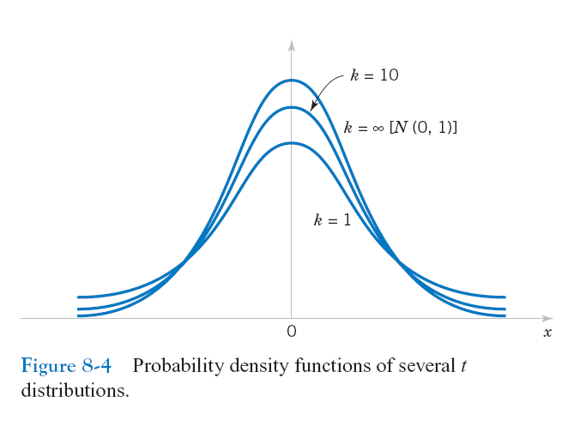
8-3 Confidence Interval on the Mean of a Normal Distribution, Variance Unknown
8-3.1 The t distribution
Figure 8-4 Probability density functions of several t distributions.

Slide 26
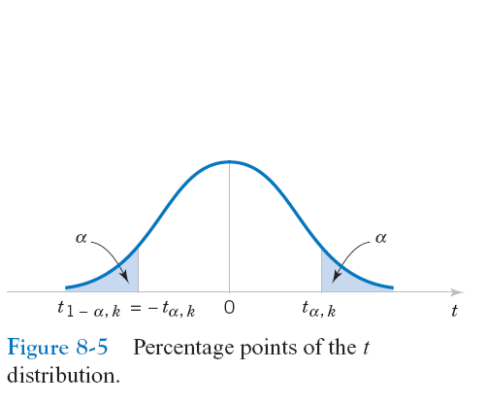
8-3 Confidence Interval on the Mean of a Normal Distribution, Variance Unknown
8-3.1 The t distribution
Figure 8-5 Percentage points of the t distribution.

Slide 27
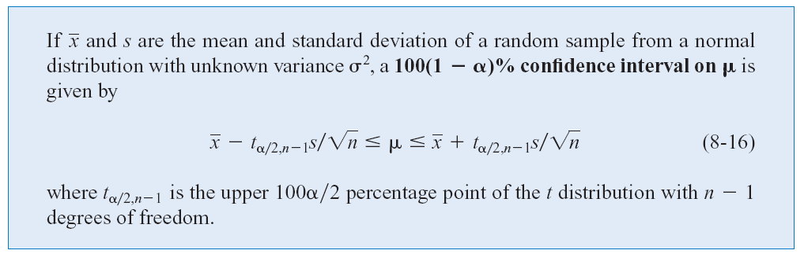
8-3 Confidence Interval on the Mean of a Normal Distribution, Variance Unknown
8-3.2 The t Confidence Interval on μ (Eq. 8-16)
One-sided confidence bounds on the mean are found by replacing t_{α/2,n-1} in Equation 8-16 with t _{α,n-1}.

Slide 28
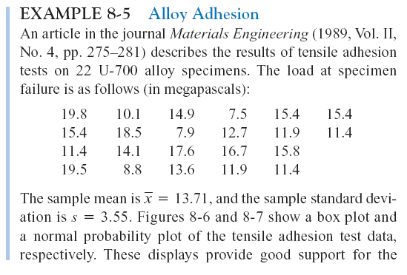
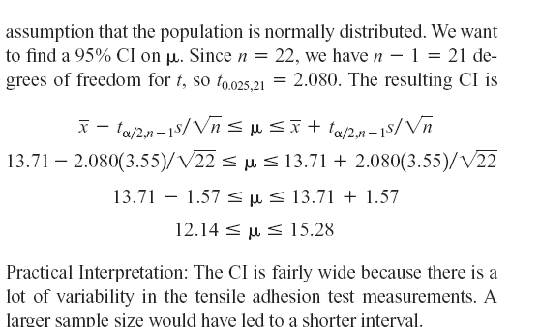
8-3 Confidence Interval on the Mean of a Normal Distribution, Variance Unknown
Example 8-5

Slide 29
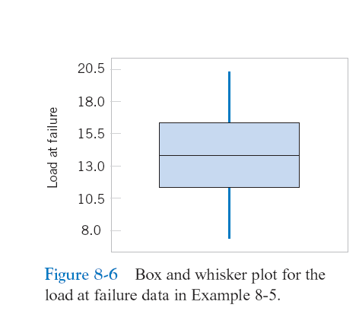
8-3 Confidence Interval on the Mean of a Normal Distribution, Variance Unknown
Figure 8-6 Box and Whisker plot for the load at failure data in Example 8-5.

Slide 30
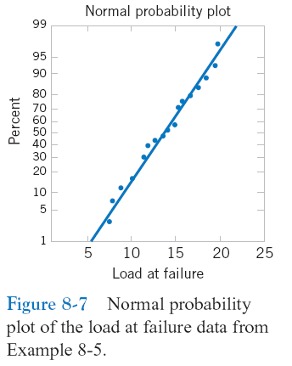
8-3 Confidence Interval on the Mean of a Normal Distribution, Variance Unknown
Figure 8-7 Normal probability plot of the load at failure data in Example 8-5.

Slide 31
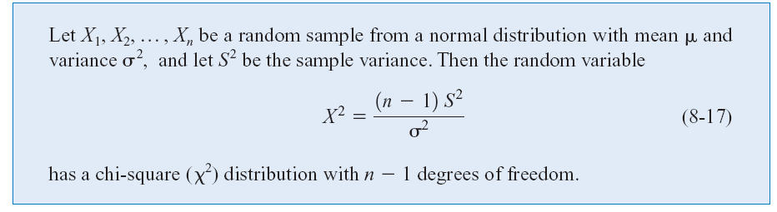
8-4 Confidence Interval on the Variance and Standard Deviation of a Normal Distribution
Definition (Eq. 8-17)

Slide 32
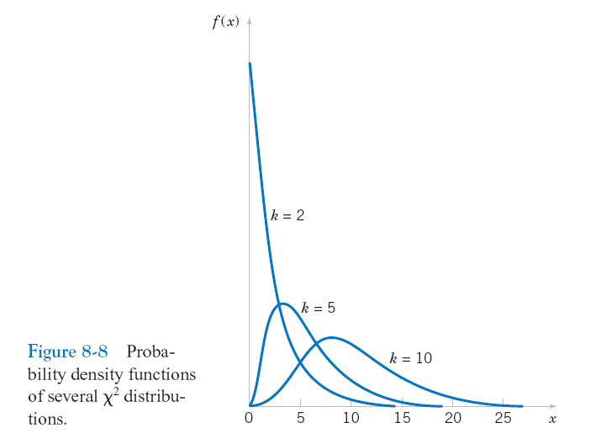
8-4 Confidence Interval on the Variance and Standard Deviation of a Normal Distribution
Figure 8-8 Probability density functions of several χ² distributions.

Slide 33
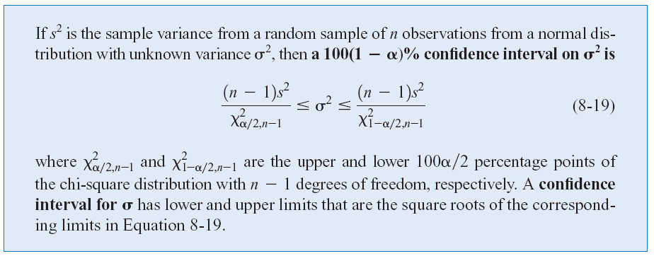
8-4 Confidence Interval on the Variance and Standard Deviation of a Normal Distribution
Definition (Eq. 8-19)

Slide 34
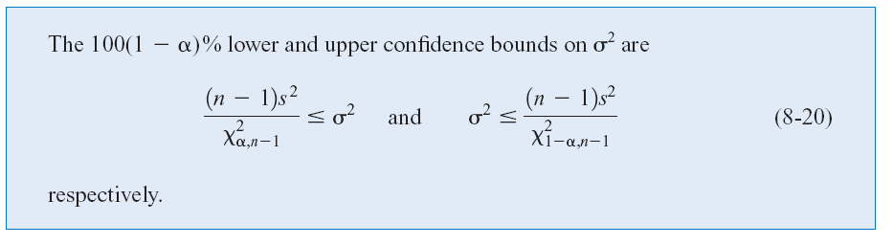
8-4 Confidence Interval on the Variance and Standard Deviation of a Normal Distribution
One-Sided Confidence Bounds (Eq. 8-20)

Slide 35
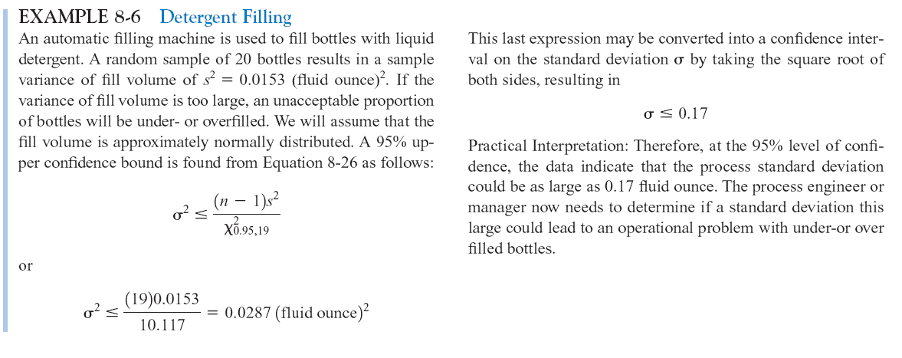
8-4 Confidence Interval on the Variance and Standard Deviation of a Normal Distribution
Example 8-6

Slide 36
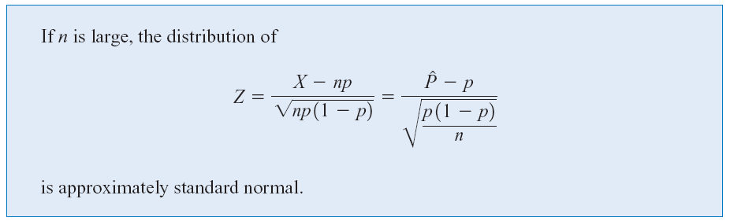
8-5 A Large-Sample Confidence Interval For a Population Proportion
Normal Approximation for Binomial Proportion
The quantity is called the standard error of the point estimator .

Slide 37
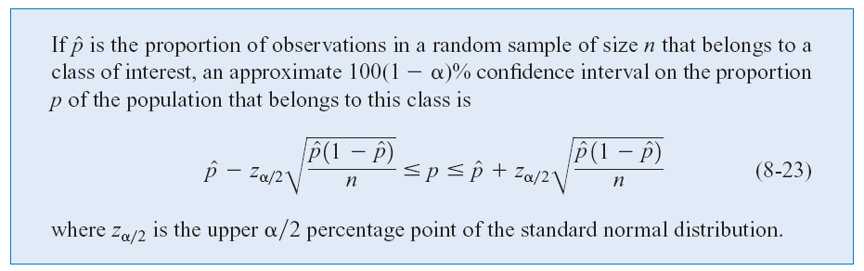
8-5 A Large-Sample Confidence Interval For a Population Proportion (Eq. 8-23)

Slide 38
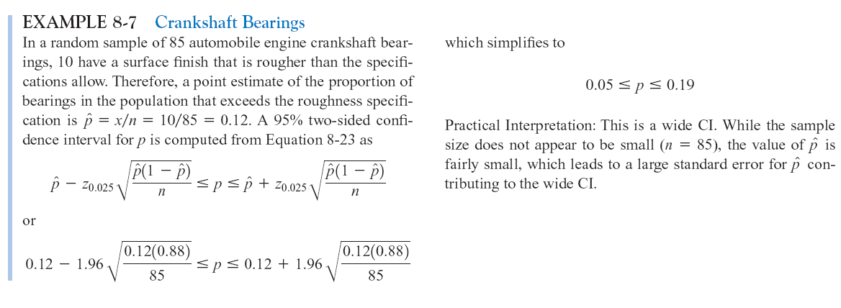
8-5 A Large-Sample Confidence Interval For a Population Proportion
Example 8-7

Slide 39
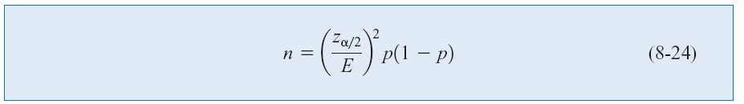

8-5 A Large-Sample Confidence Interval For a Population Proportion
Choice of Sample Size (Eq. 8-24 & 25)
The sample size for a specified value E is given by
An upper bound on n is given by

Slide 40
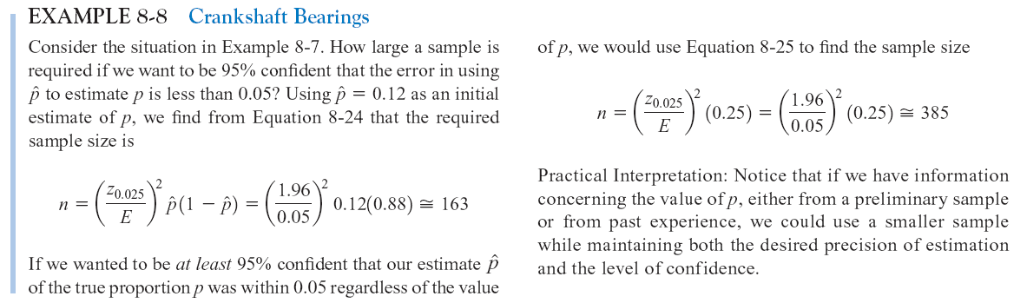
8-5 A Large-Sample Confidence Interval For a Population Proportion
Example 8-8

Slide 41
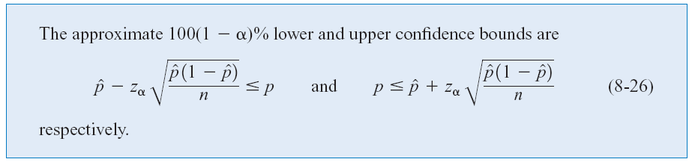
8-5 A Large-Sample Confidence Interval For a Population Proportion
One-Sided Confidence Bounds (Eq. 8-26)

Slide 42
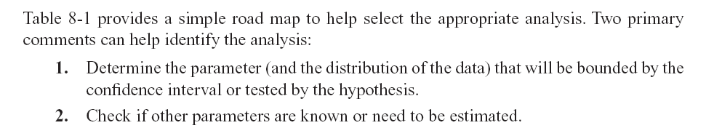
8-6 Guidelines for Constructing Confidence Intervals

Slide 43
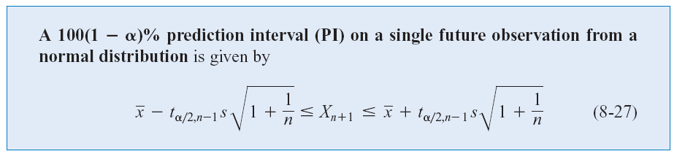
8-7 Tolerance and Prediction Intervals
8-7.1 Prediction Interval for Future Observation (Eq. 8-27)
The prediction interval for X_{n+1} will always be longer than the confidence interval for μ.

Slide 44
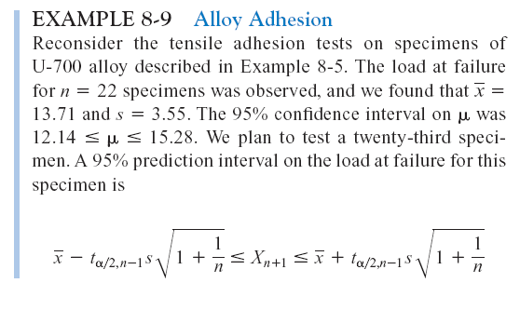
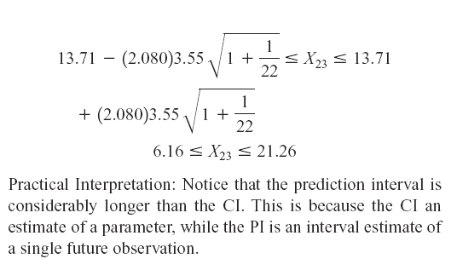
8-7 Tolerance and Prediction Intervals
Example 8-9

Slide 45
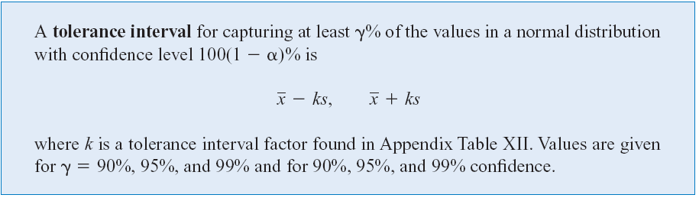
8-7 Tolerance and Prediction Intervals
8-7.2 Tolerance Interval for a Normal Distribution
Definition

Slide 46
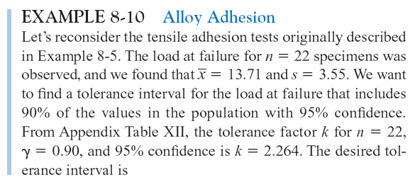
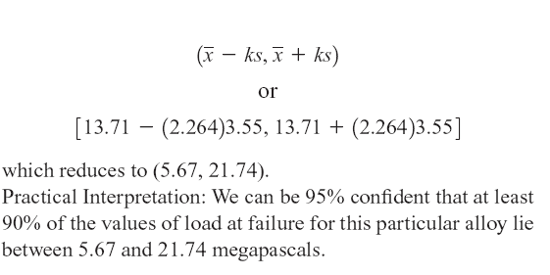
8-7 Tolerance and Prediction Intervals
Example 8-10

Slide 47
Important Terms & Concepts of Chapter 8
Chi-squared distribution
Confidence coefficient
Confidence interval
Confidence interval for a:
Population proportion
Mean of a normal distribution
Variance of a normal distribution
Confidence level
Error in estimation
Large sample confidence interval
1-sided confidence bounds
Precision of parameter estimation
Prediction interval
Tolerance interval
2-sided confidence interval
t distribution

